Slide 1
Bubble sheet multiple choice scanner and test grader using image processing techniques
2017BTECS00046
2017BTECS00062
2017BTECS00063

Slide 2
We are implementing a bubble sheet test scanner and grader using strictly computer vision and image processing techniques, along with the OpenCV library.
Also we have implemented OMR system.

Slide 3
What is Optical Mark Recognition (OMR)?
Optical Mark Recognition, or OMR for short, is the process of automatically analyzing human-marked documents and interpreting their results.

Slide 4
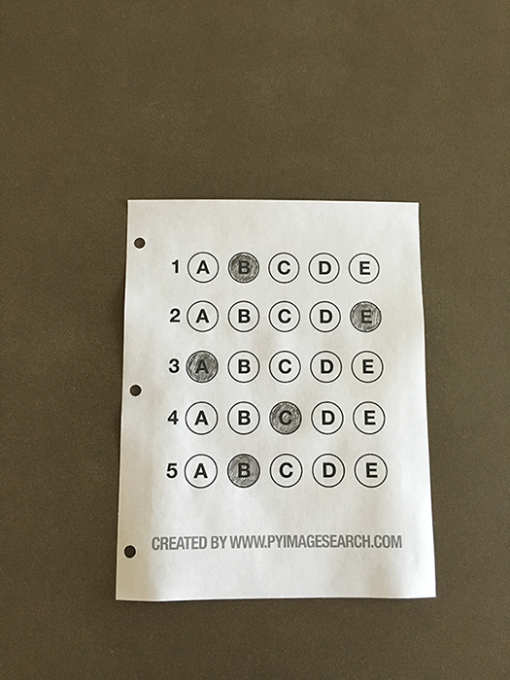
Filled in bubble sheet we are going to use when developing our test scanner software.

Slide 5
The 7 steps to build a bubble sheet scanner and grader
Step #1: Detect the exam in an image.
Step #2: Apply a perspective transform to extract the top-down, birds-eye-view of the exam.

Slide 6
Step #3: Extract the set of bubbles (i.e., the possible answer choices) from the perspective transformed exam. Step #4: Sort the questions/bubbles into rows. Step #5: Determine the marked (i.e., “bubbled in”) answer for each row.
Step #6: Lookup the correct answer in our answer key to determine if the user was correct in their choice.
Step #7: Repeat for all questions in the exam.

Slide 7
Thank You!!!

